Slide 1
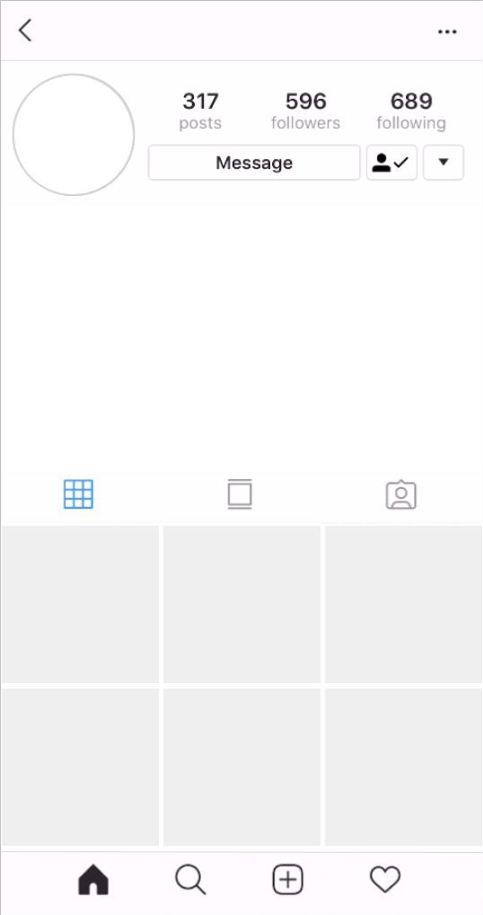
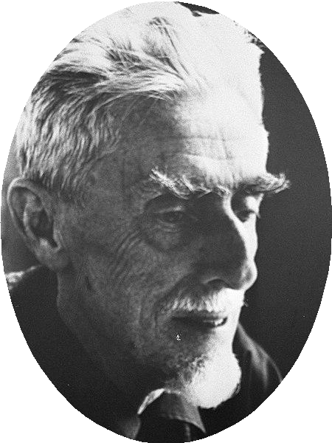
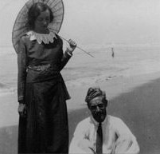
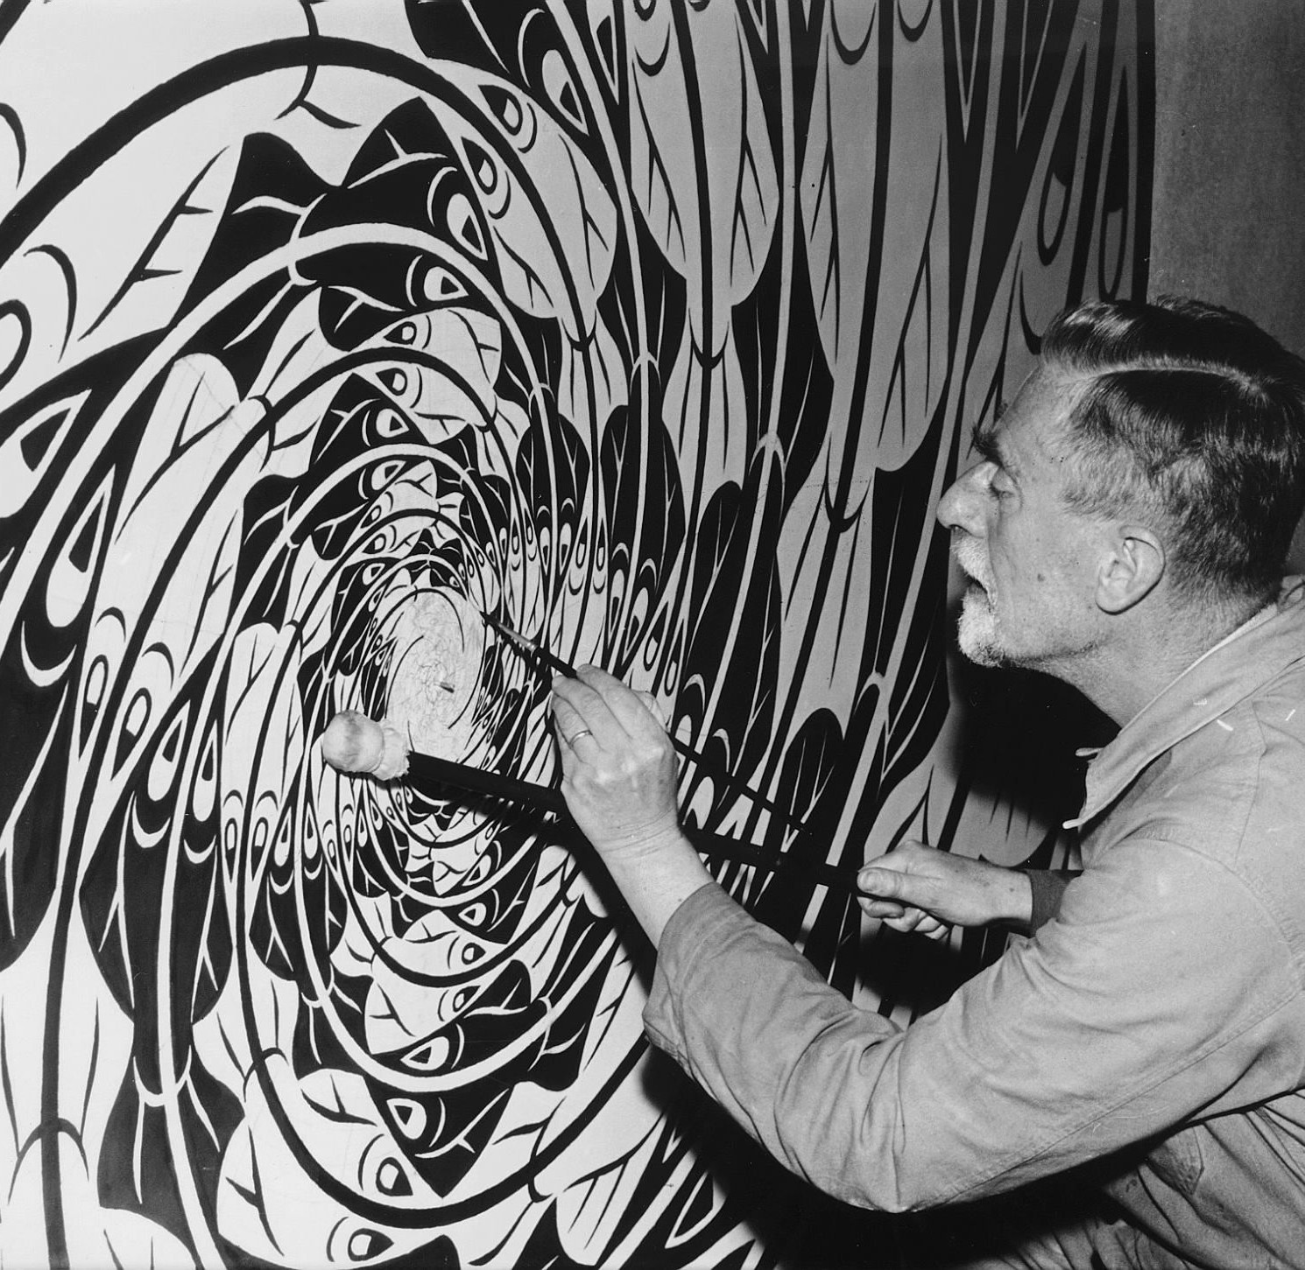
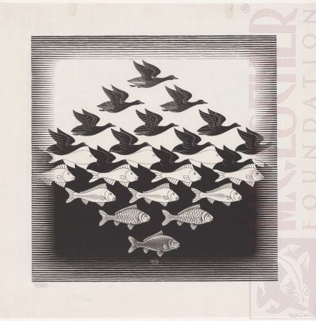
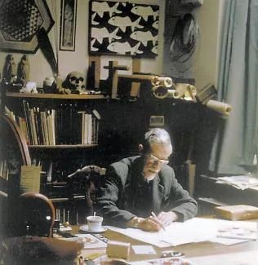
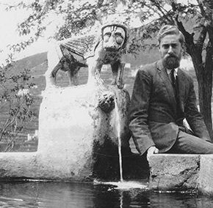
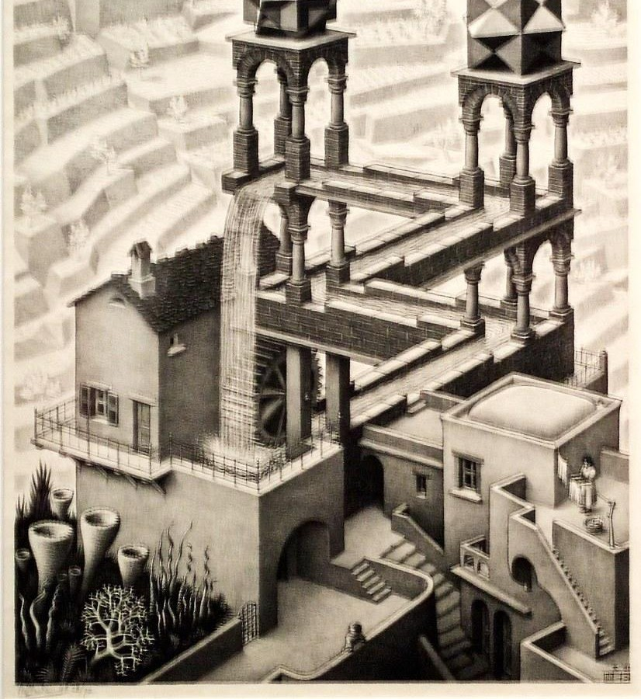
@Escher_the_sketcher
M.C. Escher, Dutch, Drawing/Printmaking, 1898-1972
I’m a left-handed, Italian inﬂuenced, graphic designer. Follow me for images of my black and white designs, optical illusions, and detailed drawings.
I strive to make the impossible visible.
Followed by: Alice Neel (Sculptor, 1900-1984), Pablo Picasso (painter, 1881-1973)

Slide 2
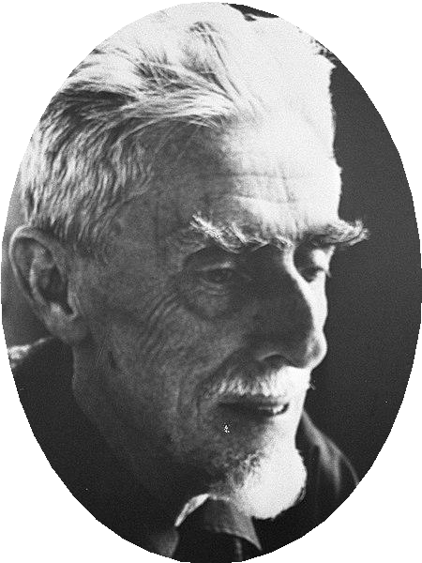
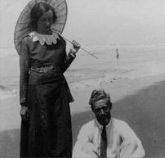
@Escher_the_sketcher
Happy Anniversary, my darling @jettaumiker. I think often of the time we spent in Italy as newlyweds and I am forever thankful that I took the leap to leave the Netherlands after school and travel. #italianlovestory #pastaisgoodforart

Slide 3
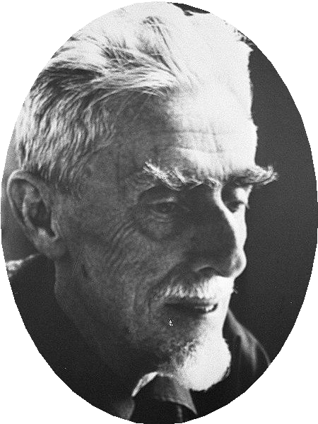

@Escher_the_sketcher
I love working big. Apart from drawing sketches, I like to create prints and large paintings. This painting is all positive and negative space and you can see that I’m holding my wrist away from the painting with a mahl stick. #drawing2painting #biggerisbetter

Slide 4

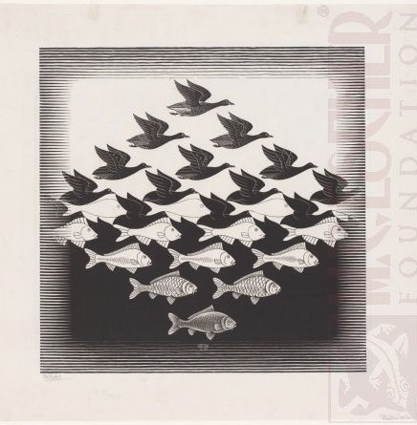
@Escher_the_sketcher
This is one of my transformation series. I like to play with the shapes and the negative space so that I can transform one being to another. #wingstoﬁns #shapesonshapes
Sky and Water I, woodcut print, 1938

Slide 5
@Escher_the_sketcher
I work alone with a cup of tea. Even though I’m known for my sketches, I produce a lot of prints. My drawings are my ideas. #drawtoprint #madeupworlds

Slide 6
@Escher_the_sketcher
I am inspired as I travel through Italy and see the art of the masters before me. Even the water as it ﬂows from this fountain makes me think of art I will make in the future. #waterfallswillreturn #traveltoinspire

Slide 7
@Escher_the_sketcher
In this lithograph, I focused on geometric lines. I’m trying to convey a sense of strength in the tall vertical towers and energy in the diagonal waterway. #makingtheimpossiblevisible #geometricillusion
Waterfall, 1961, Lithograph

